Slide 1
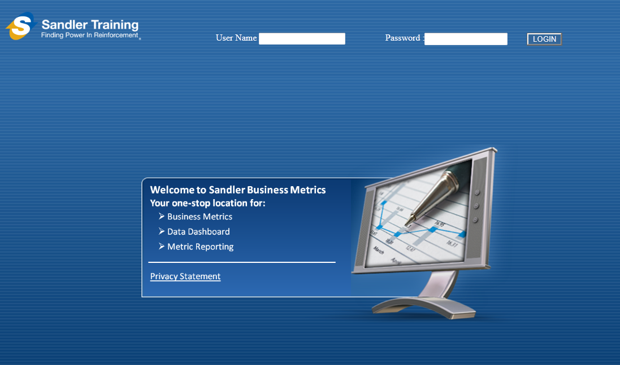


User Name:
Password:
Login
Welcome to CASCADE Asset Management
Your one-stop location for:
Acquisitions Management
Portfolio & Collections Management
Investor Management & Reporting
Asset Sales Management
Privacy Statement
Powered by Mined Systems, Inc ®
Copyright © 2011 Mined Systems Metrics Intelligence. All rights reserved.

Slide 2
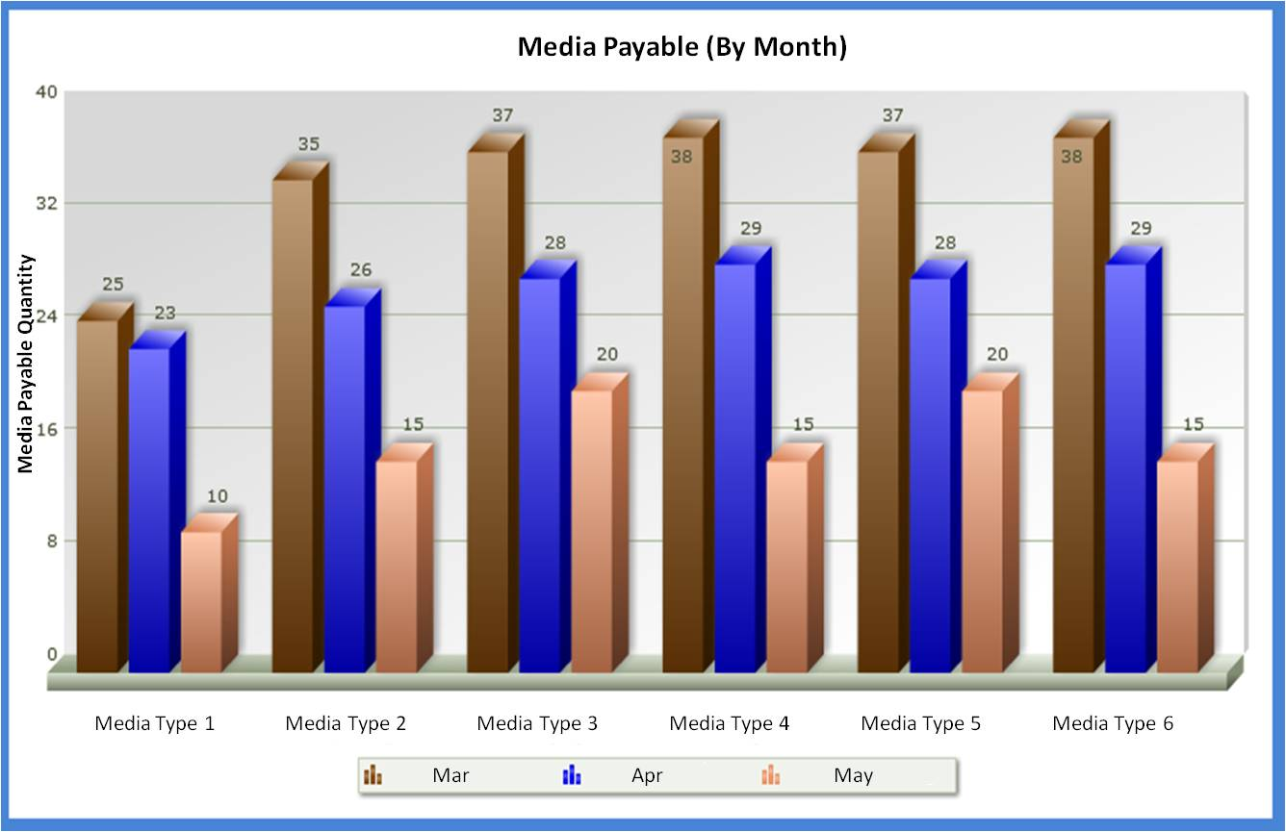
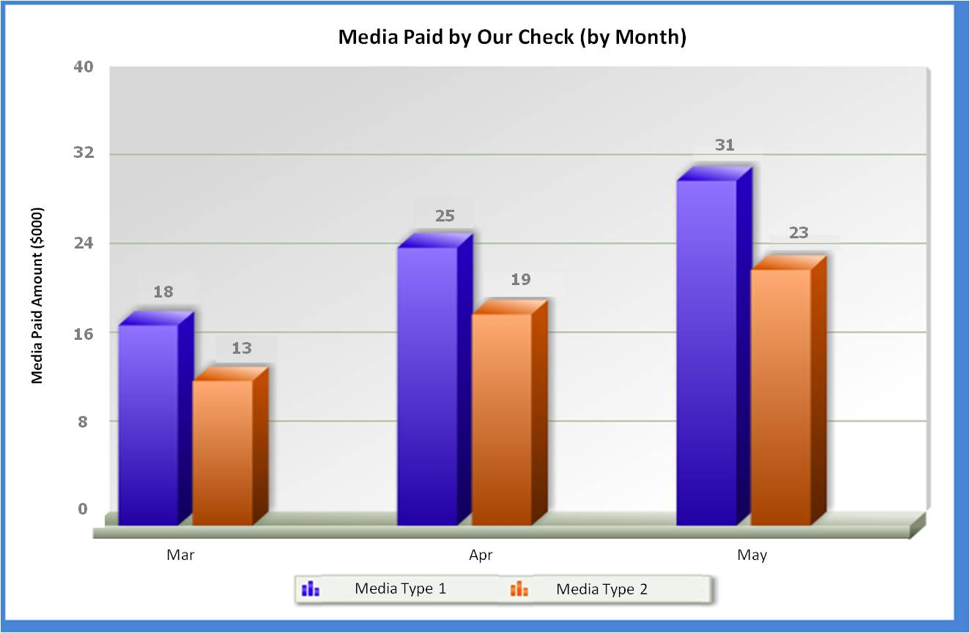
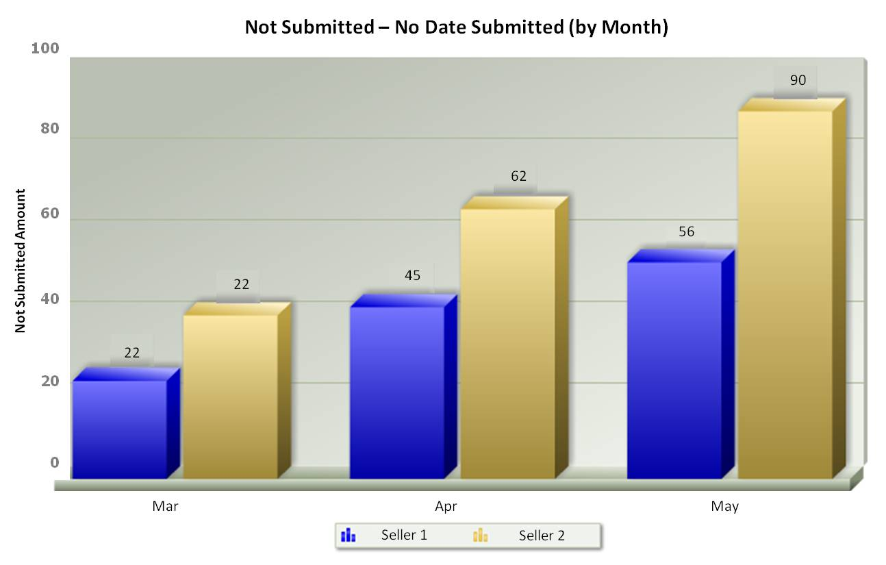
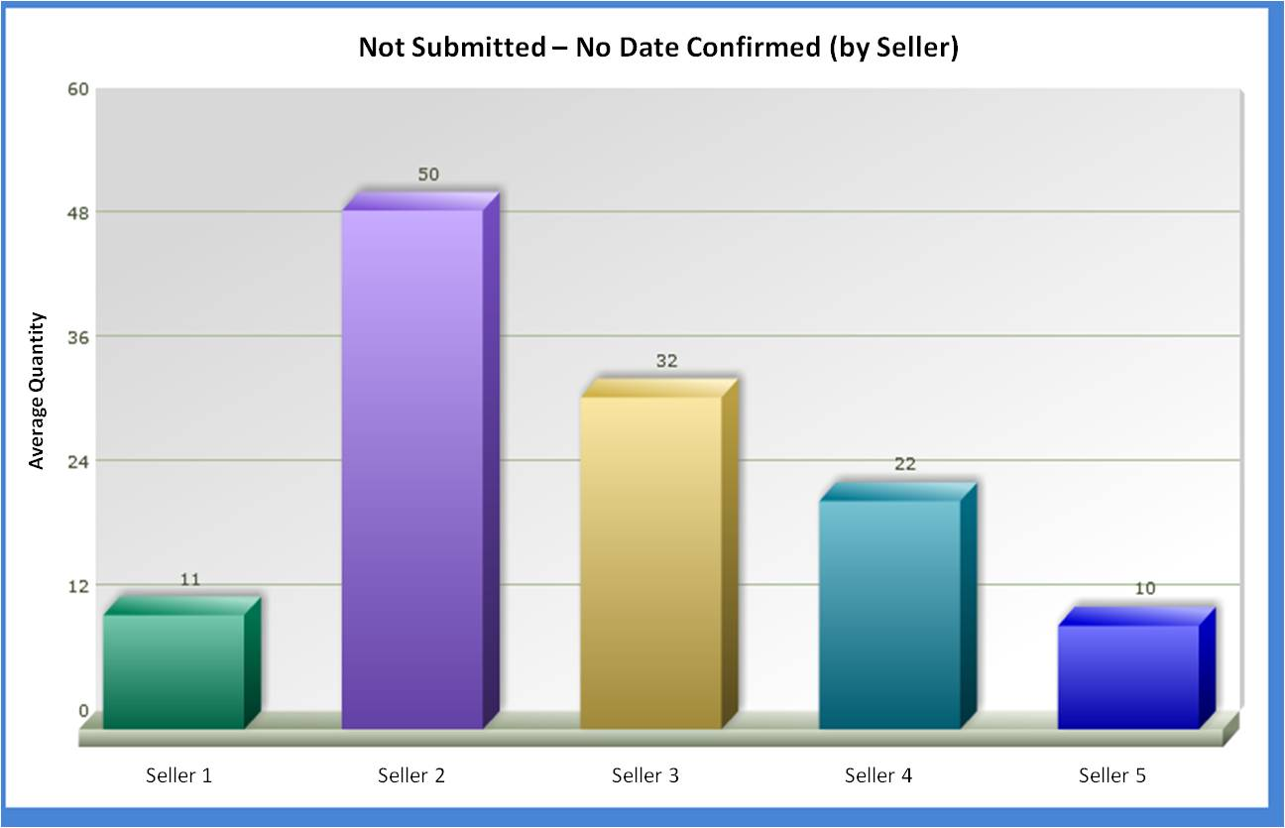

Logout
Recourse
Collections
Investor Mgt
Analytics & Simulation
Asset Sales
Search
Reports
My CRM
My Account
My Message Board
My Messages
Powered by Mined Systems Inc. ®
Copyright © 2011 – 2012 Mined Systems Inc. All rights reserved

Slide 3
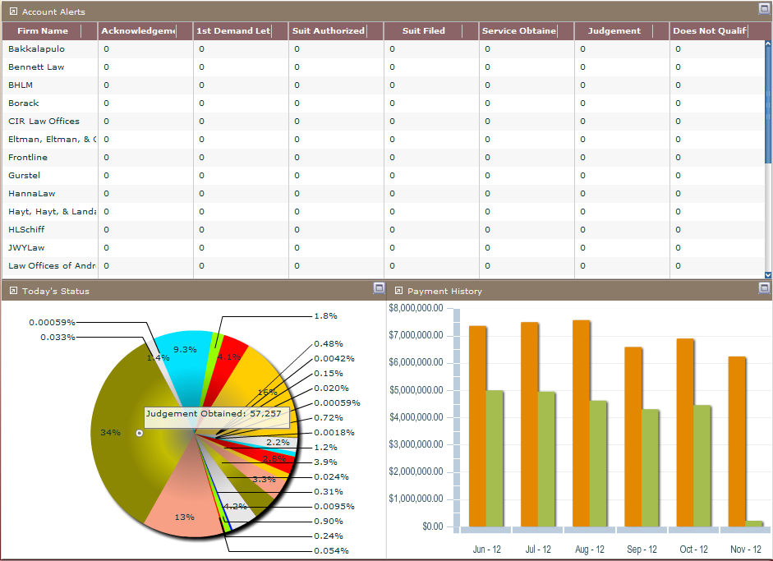
Logout
Recourse
Collections
Investor Mgt
Analytics & Simulation
Asset Sales
Powered by Mined Systems Inc. ®
Copyright © 2011 – 2012 Mined Systems Inc. All rights reserved

Slide 4
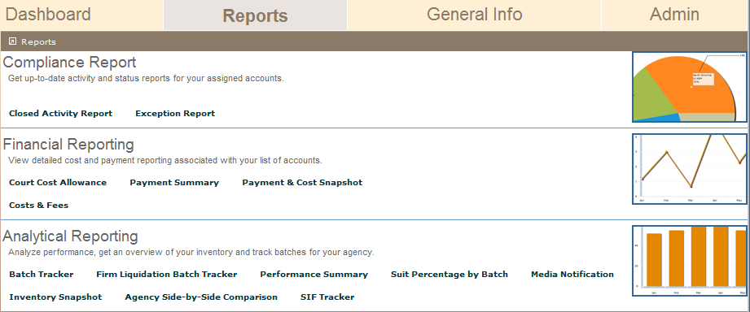
Logout
Recourse
Collections
Investor Mgt
Analytics & Simulation
Asset Sales
Powered by Mined Systems Inc. ®
Copyright © 2011 – 2012 Mined Systems Inc. All rights reserved

Slide 5
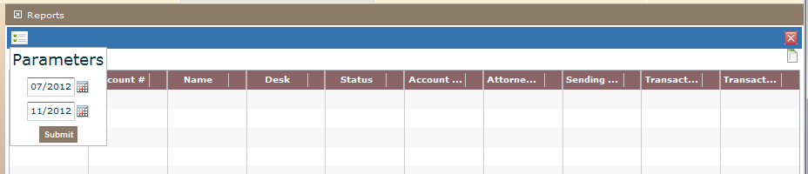
Logout
Recourse
Collections
Investor Mgt
Analytics & Simulation
Asset Sales
Closed Activity Report
Powered by Mined Systems Inc. ®
Copyright © 2011 – 2012 Mined Systems Inc. All rights reserved

Slide 6
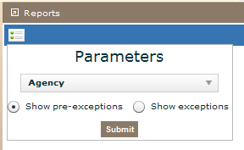
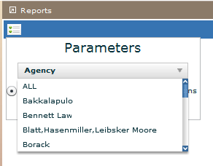
Logout
Recourse
Collections
Investor Mgt
Analytics & Simulation
Asset Sales
Exception Report
Powered by Mined Systems Inc. ®
Copyright © 2011 – 2012 Mined Systems Inc. All rights reserved

Slide 7
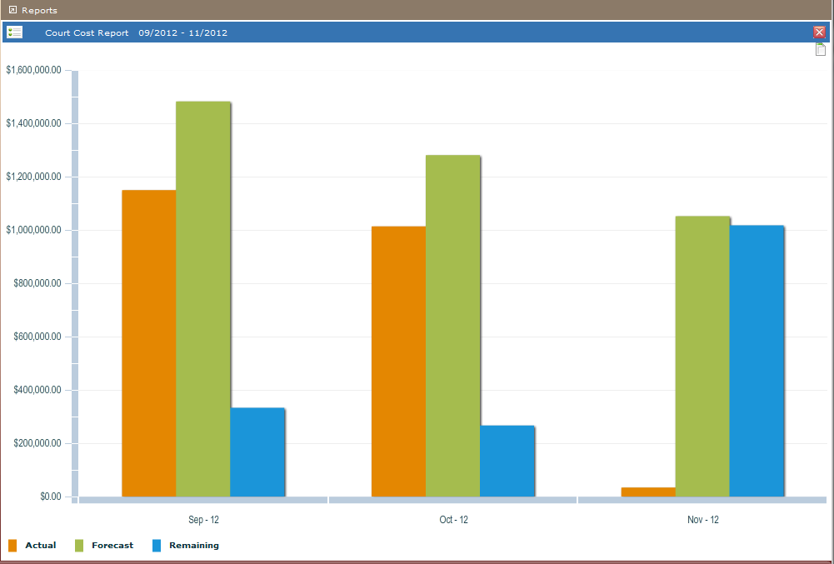
Logout
Recourse
Collections
Investor Mgt
Analytics & Simulation
Asset Sales
Court Cost Report
Powered by Mined Systems Inc. ®
Copyright © 2011 – 2012 Mined Systems Inc. All rights reserved

Slide 8
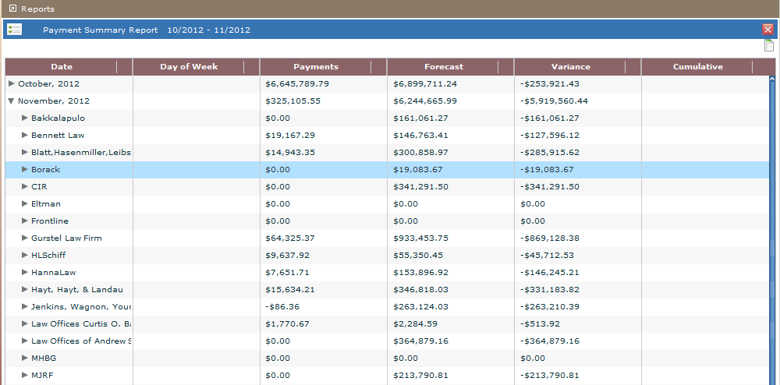
Logout
Recourse
Collections
Investor Mgt
Analytics & Simulation
Asset Sales
Payment Summary Report
Powered by Mined Systems Inc. ®
Copyright © 2011 – 2012 Mined Systems Inc. All rights reserved

Slide 9
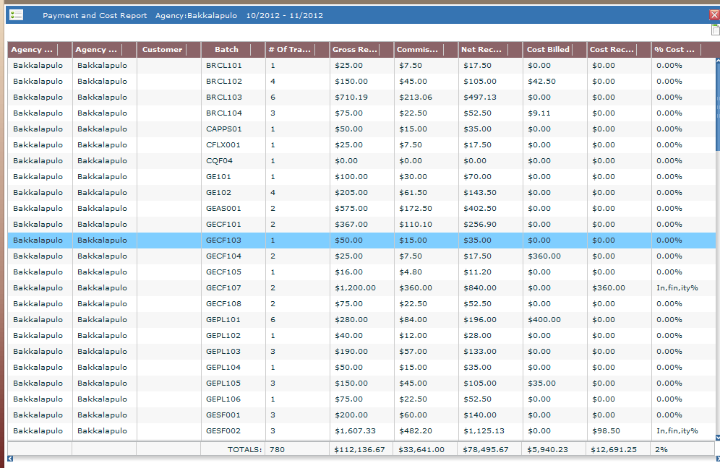
P
Logout
Recourse
Collections
Investor Mgt
Analytics & Simulation
Asset Sales
Payment Summary Report
Payment and Cost Report
Powered by Mined Systems Inc. ®
Copyright © 2011 – 2012 Mined Systems Inc. All rights reserved

Slide 10
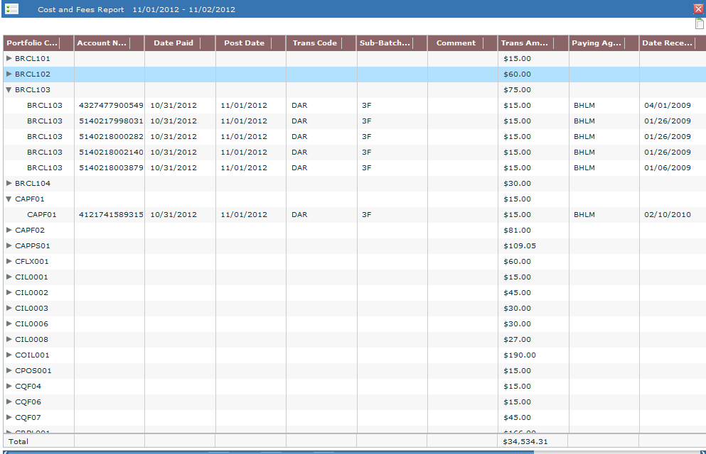
Logout
Recourse
Collections
Investor Mgt
Analytics & Simulation
Asset Sales
Cost and Fees Report
Powered by Mined Systems Inc. ®
Copyright © 2011 – 2012 Mined Systems Inc. All rights reserved

Slide 11
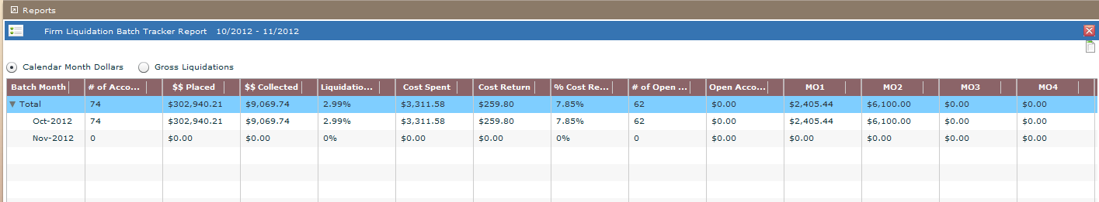
Logout
Recourse
Collections
Investor Mgt
Analytics & Simulation
Asset Sales
Firm Liquidation Batch Tracker Report - - actually goes out to 24 months
Powered by Mined Systems Inc. ®
Copyright © 2011 – 2012 Mined Systems Inc. All rights reserved

Slide 12
Logout
Recourse
Collections
Investor Mgt
Analytics & Simulation
Asset Sales
Cost and Fees Report
Powered by Mined Systems Inc. ®
Copyright © 2011 – 2012 Mined Systems Inc. All rights reserved

Slide 13
Logout
Recourse
Collections
Investor Mgt
Analytics & Simulation
Asset Sales
Powered by Mined Systems Inc. ®
Copyright © 2011 – 2012 Mined Systems Inc. All rights reserved

Slide 14
Logout
Recourse
Collections
Investor Mgt
Analytics & Simulation
Asset Sales
Powered by Mined Systems Inc. ®
Copyright © 2011 – 2012 Mined Systems Inc. All rights reserved

Slide 15
Logout
Recourse
Collections
Investor Mgt
Analytics & Simulation
Asset Sales
Powered by Mined Systems Inc. ®
Copyright © 2011 – 2012 Mined Systems Inc. All rights reserved

Slide 16
Logout
Recourse
Collections
Investor Mgt
Analytics & Simulation
Asset Sales
Powered by Mined Systems Inc. ®
Copyright © 2011 – 2012 Mined Systems Inc. All rights reserved

Slide 17
Logout
Recourse
Collections
Investor Mgt
Analytics & Simulation
Asset Sales
Powered by Mined Systems Inc. ®
Copyright © 2011 – 2012 Mined Systems Inc. All rights reserved

Slide 18
Logout
Recourse
Collections
Investor Mgt
Analytics & Simulation
Asset Sales
Powered by Mined Systems Inc. ®
Copyright © 2011 – 2012 Mined Systems Inc. All rights reserved

